Slide 1



Institute of Biomedical Research of Salamanca
Cancer Research Center
University of Salamanca
Inmunoterapia aplicada al MM
Enrique M. Ocio
University Hospital & Cancer Research Center
University of Salamanca
Spain

Slide 2
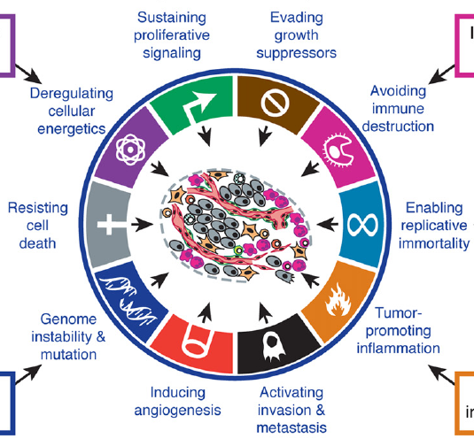
“The Hallmarks of Cancer”
Hanahan & Weinberg, Cell 2011

Slide 3
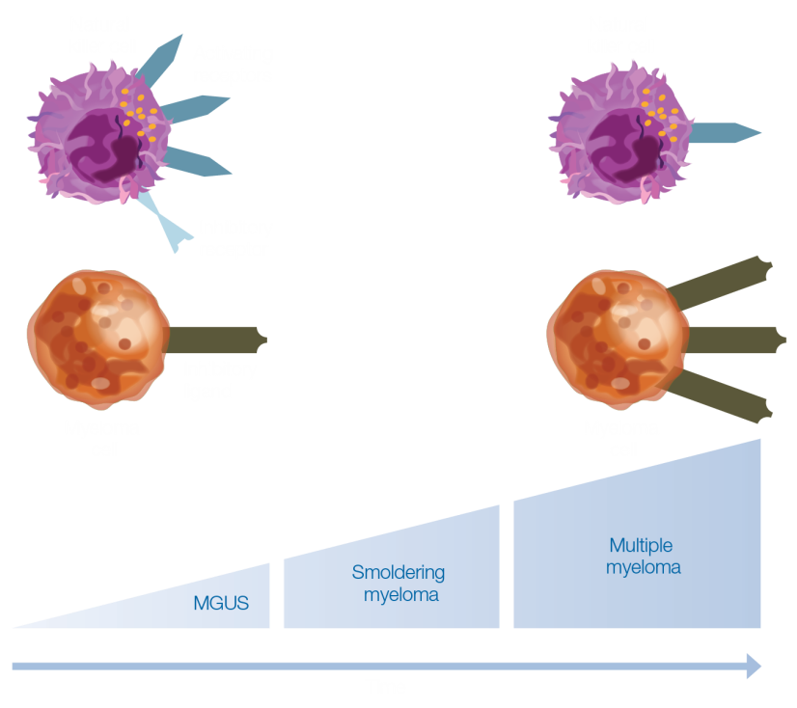
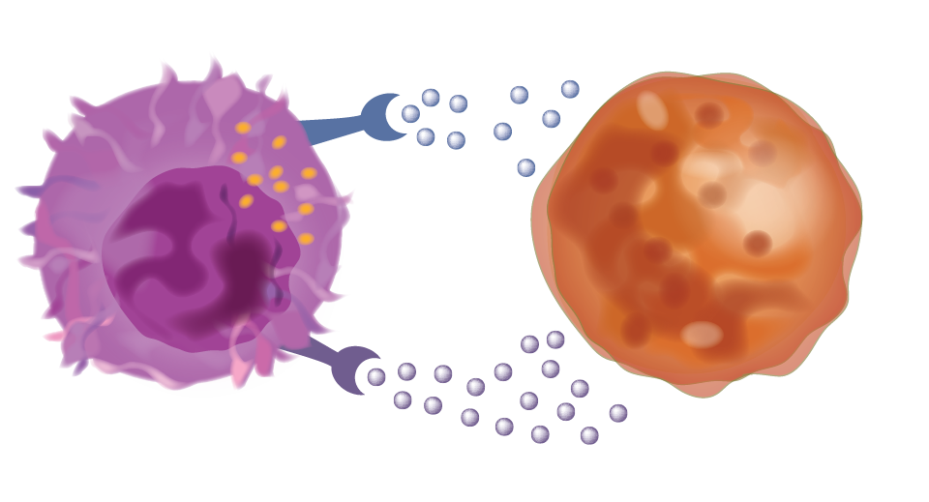
Immune impairment in MM
While the immune system is well-equipped to identify and eliminate myeloma cells, they can escape immune-mediated destruction via immune evasion and immunosuppressive strategies¹
Immune Evasion
Immunosuppression
NK cell
Activating
receptors
TGFβ1
Inhibitory
receptor
Inhibitory
cytokines
Inhibitory
ligand
MM cell
NK cell
IL-6
MM cell
TGF-β has substantial inhibitory effects on NK cell cytolytic activity³
Time
IL-6 induces NK cell dysfunction⁴ and has been proposed as an autocrine growth factor for MM^{4,5}
NKG2D receptors on NK cells²
Expression of inhibitory molecules, including MHC class I ligands²
IL-6, interleukin 6; MGUS, monoclonal gammopathy of undetermined significance; MHC, major histocompatibility complex; MM, multiple myeloma; NK, natural killer; NKG2D, natural-killer group 2, member D; TGFβ1, transforming growth factor beta 1.
1. Vesely MD et al. Ann Rev Immunol. 2011;29:235-271. 2. Godfrey J, Benson DM Jr. Leuk Lymphoma. 2012;53:1666-1676. 3. Rook AH et al.
J Immunol.1986;136:3916-3920. 4. Urashima M et al. Blood. 1996;87:1928-1938. 5. Tanner J. J Clin Invest. 1991;88:239-247

Slide 4
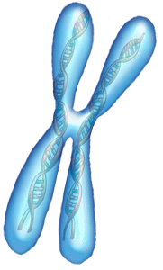
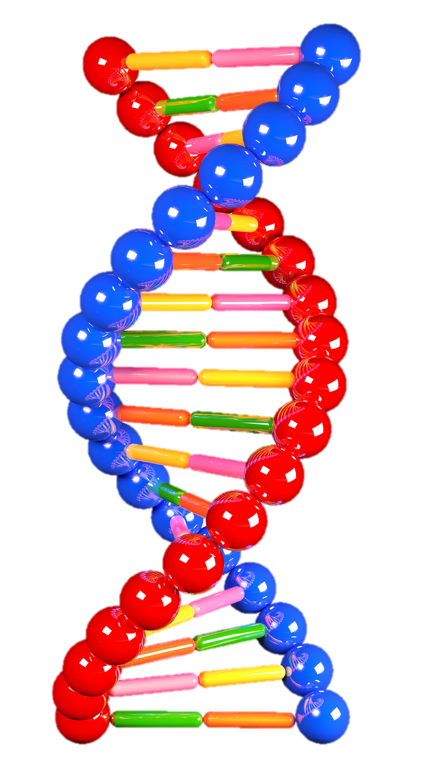
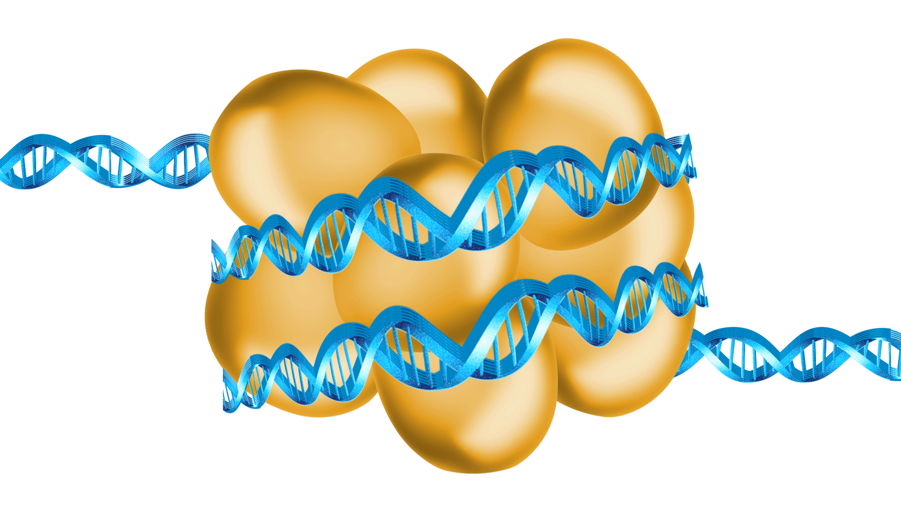
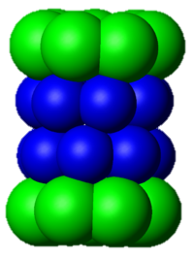
New drugs and mechanisms of action in MM
CDK 1, 2, 5, 9 Dinaciclib / TG02
FGFR3 Dovitinib / AB1010 / MFGR 1877S
cKit /PDGFR Imatinib / Dasatinib
VEGF-R Bevacizumab
IGF-1R AVE1642 / CP-751, 851
EGF-R Cetuximab
PKC Enzastaurin
BTK Ibrutinib
CS-1 Elotuzumab
CD38 Daratumumab / Isatuximab
CD138 nBT062-DM4
CD56 Lorvotuzumab
CD40 Dacetuzumab / Lucatumumab
BAFF Tabalumab
KiR IPH2101
PD1/PDL1 Pembrolizumab / Nivolumab / Pidilumab
MoAb
Kinase Inh.
Cell cycle Inh.
IL-6 Siltuximab
Lymph.
NK cell
Ras
KSP Inh Filanesib
Aurora K Inh MLN8237
CDK 4/6 Inh Seleciclib
Raf
PI3K
IMIDs
MEK
Akt
Thalidomide
Lenalidomide
Pomalidomide
Alkylators
Melphalan
Cyclophosphamide
Bendamustine
Melflufen
TH-302
mTORC1
mTORC2
MAPK
Signaling Pathways
AKT Perifosine / Afuresertib
mTORC1 Everolimus / Temsirolimus
mTOR C1/C2 MLN0128 / INK128
Farn Transf Tipifarnib
p38/MAPK inh SCIO-469
p38/JNK act Aplidin
MEK Selumetinib
Bcl-2 Venetoclax
XPO Selinexor
PIM PIM447
Other DNA damaging
Proteasome Inh.
DACi
DNA Damaging Zalypsis
PARP Inhibitor Veliparib
Bortezomib
Carfilzomib
Ixazomib
Oprozomib
Marizomib
Hsp-90 Inh.
Panobinostat
Vorinostat
Romidepsin
Givinostat
Rocilinostat
Tanespimycin
AUY922
Approved
Ocio, Leukemia 2014. Updated

Slide 5
Immune-therapies under investigation in Cancer
Immunotherapy^{1,2}
Active
(Designed to act on the immune system itself)
Passive
(Designed to act on the tumor)
I-O
therapies
Therapeutic
cancer vaccines
Antitumor
mAbs
Unspecific
Adoptive
Immune effector
cell modulators
Checkpoint
Inhibitors
Co-stimulatory agonists
Cell-based
DC-based cancer vaccines
Single antigen/
peptide-based
Cytokines
Interleukins
Interferons
IMiDs
Tumor-directed mAbs
Ab-drug Conjugates (ADC)
Cell therapies
Adoptive T-cell therapy
DC, dendritic cell; IMiD, immunomodulatory agent; I-O, immuno-oncology; mAb, monoclonal antibody.
Finn OJ. Ann Oncol. 2012;23(suppl 8 ):viii6-viii9. 2. Mellman I et al. Nature. 2011;480:480-489.

Slide 6
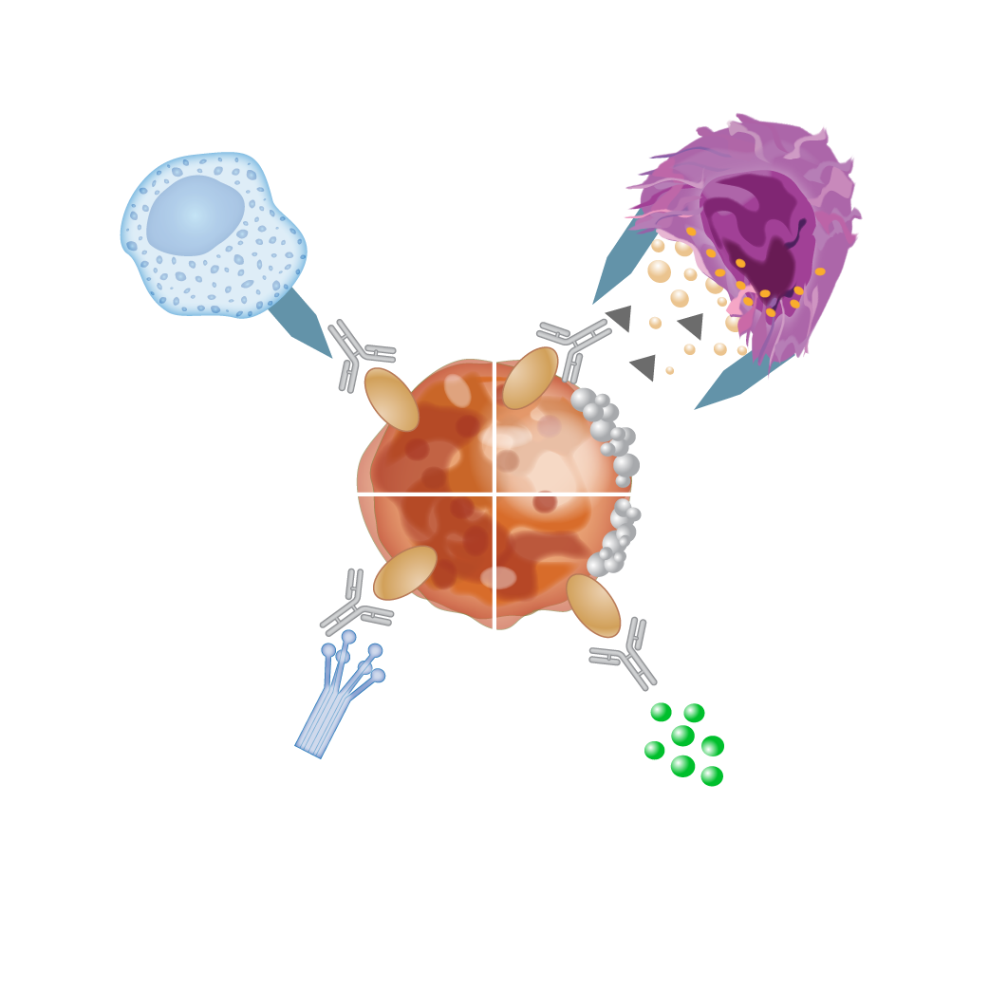
Tumor-directed MoAb: Passive immunotherapy
Macrophage-mediated ADCP¹
Macrophages recruited to engulf tumor cells
NK cell–mediated ADCC²
Target cell death induced via release of cytotoxic granules or expression of cell death–inducing molecules
Apoptosis
Apoptosis
Growth
factors
Complement protein-mediated CDC²
Complement proteins recruited to initiate complement cascade, resulting in cell death via plasma membrane pore formation
Direct induction of myeloma cell apoptosis^{3,4}
Antibodies block proteins required for tumor survival/ induce apoptotic signaling cascades
Adapted from Brody J et al. 2011⁵ and Bakema JE et al. 2014.¹
ADCC, antibody-dependent cellular cytotoxicity; ADCP, antibody-dependent cellular phagocytosis; CDC, complement-dependent cytotoxicity, NK=natural killer.
1. Bakema JE, van Egmond M. Curr Top Microbiol Immunol. 2014;382:373-392. 2. Wang SY, Weiner G. Expert Opin Biol Ther. 2008;8:759-768.
3. Metzger-Filho O et al. Clin Cancer Res. 2013;19:5552-5556. 4. Weiner GJ. Semin Hematol. 2010:47:115-123. 5. Brody J et al. J Clin Oncol. 2011;29:1864-1875.
Notes:
Ref 1: pg 377; c1; para 1
Ref 5: pg 1867; figure 1
Ref 1: pg 377; figure 1
Ref 2: pg 760; column 2; para 1/pg 761; column 2; para 2
Ref 2: pg 761; c2; para 2
Ref 3: pg 5553; c1; para 2
Ref 4: pg 116; c1; para 5; c2; para 1

Slide 7
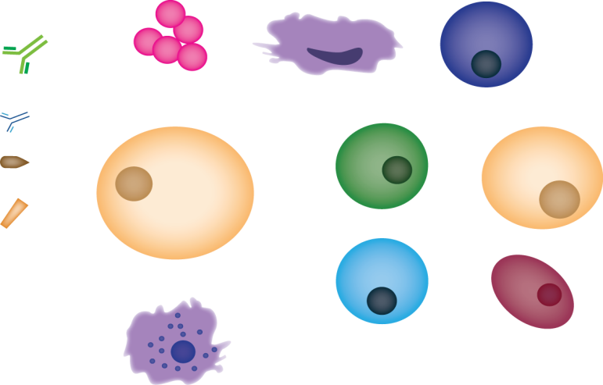
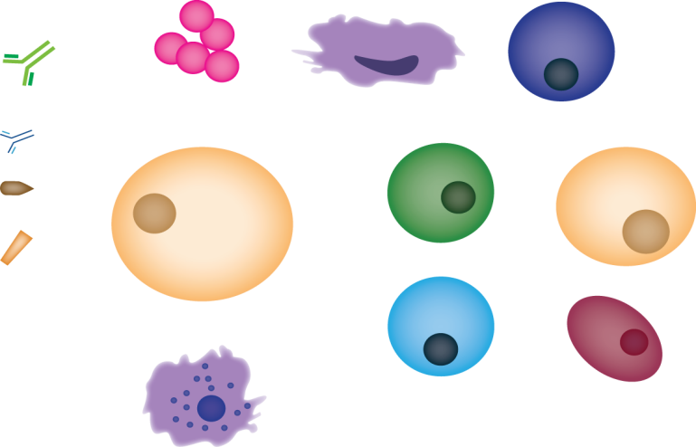








Daratumumab (Anti-CD38): Mech. Of Action
CD38 is highly and ubiquitously expressed on myeloma cells^{1,2}
DARA is a human IgG1 monoclonal antibody that binds CD38-expressing cells
DARA binding to CD38 induces tumor cell death through direct and indirect mechanisms³⁻⁵
DARA
Immune-mediated activity
Direct
anti-tumor effect
Immunomodulation
Decreased
immunosuppression
CD38 enzymatic
inhibition
CDC
ADCP
ADCC
Apoptosis via cross-linking
Complement
Macrophage
NK cell
CD38⁺
T reg
DARA
MM cell
CD38
cADPR
NAD
Ca²⁺
AMP
ADPR
DARA
Ca²⁺
Ca²⁺
NAADP
CD38
Ca²⁺
Adenosine
MM cell
CD8⁺
T cell
Adenosine
1. Lin P, et al. Am J Clin Pathol. 2004;121(4):482-488.
2. Santonocito AM, et al. Leuk Res. 2004;28(5):469-477.
3. de Weers M, et al. J Immunol. 2011;186(3):1840-1848.
4. Overdijk MB, et al. MAbs. 2015;7(2):311-321.
5. Krejcik J, et al. Presented at: ASH 2015. Abstract 3037.
Tumor cell
death
CD38
B reg
MDSC
CD38

Slide 8
Daratumumab in monotherapy:
Two studies: GEN501 & SIRIUS
GEN501
SIRIUS
Dose-escalation
Randomization
≥18 years of age, ECOG status ≤2^{1,2}
GEN501¹
Open-label, multicenter, phase 1/2, dose-escalation and dose-expansion study
Relapsed from or refractory to ≥2 prior lines of therapy including PIs and IMiDs
SIRIUS²
Open-label, multicenter, phase 2 study
Patients had received ≥3 prior lines of therapy, including a PI and an IMiD, or were double refractory to a PI and an IMID
DARA was approved by the FDA on November 16, 2015, based on these studies
Doses from 0.005-24 mg/kg
(n = 32)
16 mg/kg (n = 16)
8 mg/kg (n = 18)
Safety and response evaluated
Response evaluated
Additional 90 patients enrolled at DARA 16 mg/kg
Dose-expansion
16 mg/kg (n = 42)
8 mg/kg (n = 30)
16 mg/kg
(n = 106)
16 mg/kg
N = 148
1. Lokhorst HM, et al. N Engl J Med. 2015;373(13):1207-1219.
2. Lonial S, et al. Lancet. 2015. In press.
Usmani S, ASH 2015 Abst 29
Notes:
Dosing schedule for DARA established aa 16 mg/kg weekly for 8 weeks, every 2 weeks for 16 weeks and monthly thereafter.

Slide 9
Daratumumab GEN501 & Sirius: Baseline characteristics
16 mg/kg | GEN501, Part 2 n = 42 | SIRIUS n = 106 | Combined N = 148
Median (range) age, y | 64.0 (44-76) | 63.5 (31-84) | 64 (31-84)
Median (range) time since diagnosis, y | 5.8 (0.8-23.7) | 4.8 (1.1-23.8) | 5.1 (0.8-23.8)
Median (range) number of prior lines >3 prior lines, n (%) | 4 (2-12) 26 (62) | 5 (2-14) 87 (82) | 5 (2-14) 113 (76)
Refractory to:
Last line of therapy | 32 (76) | 103 (97) | 135 (91)
Both PI and IMiD | 27 (64) | 101 (95) | 128 (86)
PI + IMiD + alkylating agent | 21 (50) | 79 (75) | 100 (68)
Bortezomib | 30 (71) | 95 (90) | 125 (84)
Carfilzomib | 7 (17) | 51 (48) | 58 (39)
Lenalidomide | 31 (74) | 93 (88) | 124 (84)
Pomalidomide | 15 (36) | 67 (63) | 82 (55)
Usmani S. ASH 2015. Abs. 29

Slide 10
Daratumumab (Anti-CD38) in MM: GEN501 & Sirius
Change in baseline M-component
ORR: 31%
100
75
50
Relative change in paraprotein from baseline, %
25
sCR
0
CR
–25
–50
VGPR
–75
–100
Patient
–90
SIRIUS
GEN501 Part 2
Depth & Duration of Response
VGPR
PR
CR
VGPR
VGPR
VGPR
PR
sCR
CR
PR
VGPR
PR
sCR
PR
PR
VGPR
PR
PR
PR
VGPR
PR
VGPR
SIRIUS
VGPR
PR
PR
PR
sCR
GEN501 Part 2
PR
VGPR
PR
PR
Patient
PR
VGPR
VGPR
PR
VGPR
PR
PR
Stringent complete response Complete response Very good partial response
Partial response
X Progressive disease
PR
sCR
VGPR
PR
PR
PR
CR
PR
Median (range) time to
≥PR = 0.95 (0.5-5.6) months
≥VGPR = 1.45 (0.5-15.6) months
PR
VGPR
VGPR
PR
PR
PR
PR
PR
PR
PR
PR
PR
VGPR
PR
VGPR
PR
PR
0
1
2
3
4
5
6
7
8
9
10
11
12
13
14
15
16
17
18
19
20
Usmani S. ASH 2015. Abs. 29
Time from first dose, months

Slide 11
TED10893
Efficacy of Isatuximab
Randomized
ORR 29%
ORR 24%
ORR 20%
ORR 9%
Time to first response, mo | 2.4 (0.9–3.9) | 2.0 (0.8– 2.0) | 0.9 (0.9–3.7) | 1.4 (0.9–2.8)
Follow-up ongoing (22 patients remain on treatment)
Interim analysis results. Data cut-off: Nov 6, 2015.
*Response defined according to IMWG criteria for all treated patients
mo, months; VGPR, very good partial response
Martin T, ASH 2015 Abst 509

Slide 12
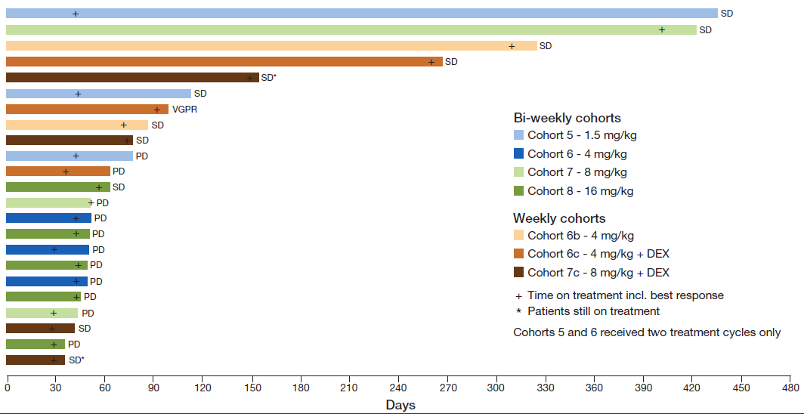
MOR202 single-agent in MM: phase 1/2a trial
N= 28 MM patient. Prior lines of therapy: 4
1 VGPR & 11 SD
Some patients received Dex
MTD not reached
Infusion-related reactions: 31% (mainly during first infusion) and all G1-2 except one case G3
Raab, MS et al. ASCO 2015 (Abstract 8574), poster presentation

Slide 13
MMY1001: Daratumumab + Backbone treatments
VD Bort (1.3 mg/m² twice weekly x 4 cycles, then once weekly x 14 cycles) / Dex (20 mg)ª
Newly diagnosed n = 6
VMP Bort (1.3 mg/m² twice weekly x 1 cycle, then weekly x 8 cycles) / Melph (9 mg/m²) / Pred (60 mg/m²)^{b}
Newly diagnosed transplant ineligible n = 12
VTD Bort (1.3 mg/m² twice weekly x 4 cycles, then weekly x 14 cycles) / Thal (100 mg daily x 21 days) Dex (20 mg)ª
Newly diagnosed; n = 12
Pom-D Pomalidomide (4 mg once daily) / Dex (40 mg)^{c}
R/R, ≥2 lines of therapy, including lenalidomide and bortezomib; n = 50 subjects maximum
ORR:
100% in newly diagnosed
50% in relapsed
ªDaratumumab once weekly x 2 cycles, then once every 3 weeks x 16 cycles or until transplantation.
^{b}Daratumumab once weekly x 1 cycle, then every 3 weeks x 8 cycles.
^{c}Daratumumab once weekly x 2 cycles, then once every 2 weeks x 4 cycles, then once every 4 weeks x 7 cycles or until disease progression; dexamethasone 20 mg if age >75 y.
Moreau, ASH 2014

Slide 14
Castor: Bort-Dex +/- Daratumumab
1.0
PFS
DVd
Vd
0.8
Median PFS: not reached
0.6
P<0.0001
Proportion surviving without progression
ORR=83%
0.4
Median PFS: 7.2 months
5%
≥CR: 19%
15%
0.2
ORR=63%
HR: 0.39 (95% CI, 0.28-0.53); P<0.0001
≥CR: 9%
2%
≥VGPR: 59%
7%
0
0
3
6
9
12
15
40%
20%
≥VGPR: 29%
No. at risk
Vd
DVd
Months since randomization
247
251
182
215
106
146
25
56
5
11
0
0
34%
1.0
TTP
DVd
24%
Vd
0.8
Median TTP: not reached
0.6
ORR, overall response rate; sCR, stringent complete response; CR, complete response; VGPR, very good partial response; PR, partial response;
DVd, daratumumab/bortezomib/dexamethasone; Vd, bortezomib/dexamethasone.
Proportion surviving without progression
0.4
Median TTP: 7.3 months
0.2
HR: 0.30 (95% CI, 0.21-0.43); P<0.0001
0
0
3
6
9
12
15
No. at risk
Vd
DVd
Months since randomization
Palumbo, ASCO 2016
247
251
181
214
106
145
25
56
5
11
0
0

Slide 15
Pollux: Len-Dex +/- Daratumumab
1.0
12-month PFS*
18-month PFS*
83%
78%
0.8
DRd
60%
0.6
52%
Proportion surviving without progression
Rd
0.4
Median PFS: 18.4 months
0.2
HR: 0.37 (95% CI, 0.27-0.52; P <0.0001)
0
0
3
6
9
12
15
18
21
No. at risk
Months
Rd
DRd
283
286
249
266
206
248
179
232
139
189
36
55
5
8
0
0
63% reduction in the risk of disease progression or death for DRd vs Rd
Dimopoulos, EHA 2016

Slide 16
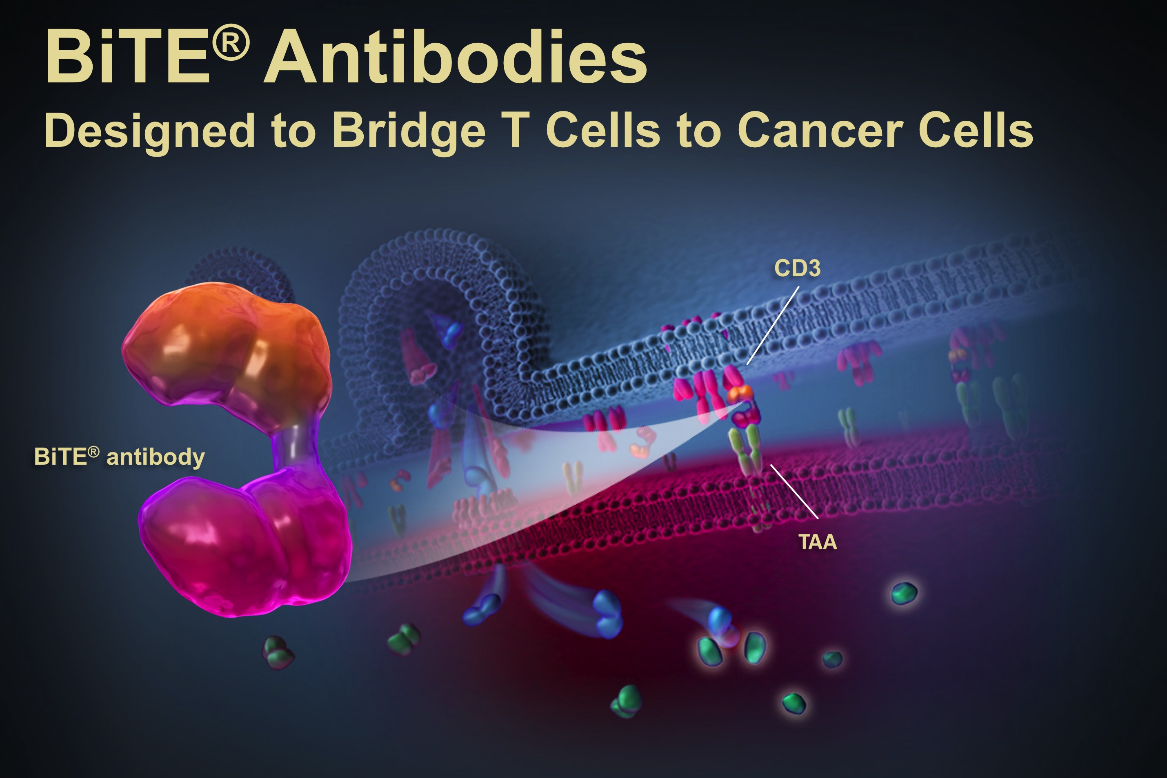
Bispecific Antibodies
Notes:
Ref 1: pg 377; c1; para 1
Ref 5: pg 1867; figure 1
Ref 1: pg 377; figure 1
Ref 2: pg 760; column 2; para 1/pg 761; column 2; para 2
Ref 2: pg 761; c2; para 2
Ref 3: pg 5553; c1; para 2
Ref 4: pg 116; c1; para 5; c2; para 1

Slide 17
Bispecific Antibodies: BITE® Platform
Notes:
Ref 1: pg 377; c1; para 1
Ref 5: pg 1867; figure 1
Ref 1: pg 377; figure 1
Ref 2: pg 760; column 2; para 1/pg 761; column 2; para 2
Ref 2: pg 761; c2; para 2
Ref 3: pg 5553; c1; para 2
Ref 4: pg 116; c1; para 5; c2; para 1

Slide 18
Immune-therapies under investigation in Cancer
Immunotherapy^{1,2}
Active
(Designed to act on the immune system itself)
Passive
(Designed to act on the tumor)
I-O
therapies
Therapeutic
cancer vaccines
Antitumor
mAbs
Unspecific
Adoptive
Immune effector
cell modulators
Checkpoint
Inhibitors
Co-stimulatory agonists
Cell-based
DC-based cancer vaccines
Single antigen/
peptide-based
Cytokines
Interleukins
Interferons
IMiDs
Tumor-directed mAbs
Ab-drug Conjugates (ADC)
Cell therapies
Adoptive T-cell therapy
DC, dendritic cell; IMiD, immunomodulatory agent; I-O, immuno-oncology; mAb, monoclonal antibody.
Finn OJ. Ann Oncol. 2012;23(suppl 8 ):viii6-viii9. 2. Mellman I et al. Nature. 2011;480:480-489.

Slide 19
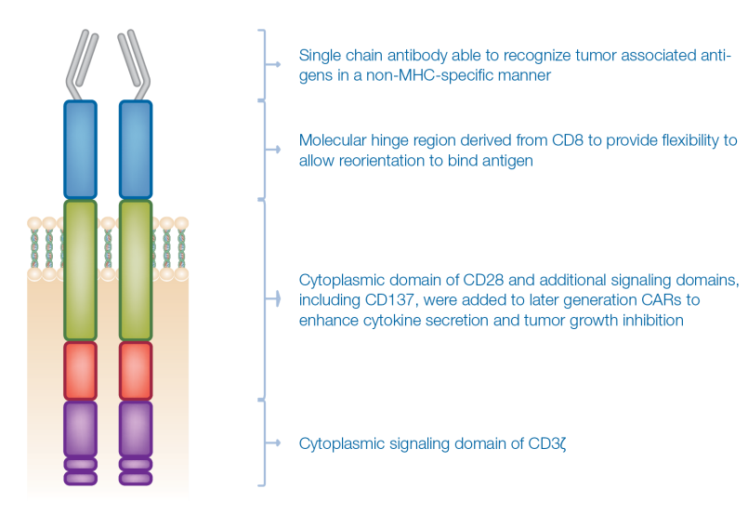
Adoptive T cell therapy: CAR-T cells
CAR T or NK cells are engineered anti-tumor immune cells with high affinity chimeric antigen receptors specific for tumor antigens¹
Chimeric Antigen Receptor Structure¹
Single-chain antibody able to recognize tumor-associated antigens in a non-MHC–specific manner
Molecular hinge region derived from CD8 to provide flexibility to allow reorientation to bind antigen
Cytoplasmic domain of CD28 and additional signaling domains, including CD137, were added to later generation CARs to enhance cytokine secretion and tumor growth inhibition
Cytoplasmic signaling domain of CD3ζ
1. Kershaw MH et al. Nat Rev Cancer. 2013;13:525-541.
Turtle CJ, Hudecek M, Curr Opin Immunol, 2012

Slide 20
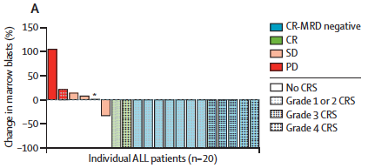
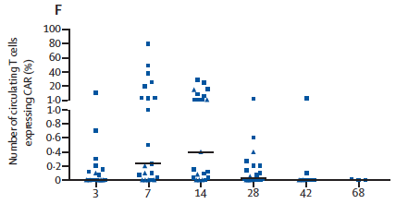
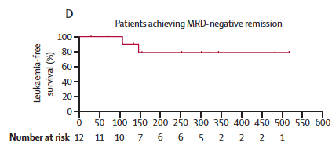
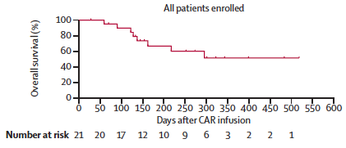
CAR-T cells in B-ALL
Phase 1b trial.
CD19-CAR: anti-CD19 + TCR zeta + CD28
21 relapse or refractory ALL and NHL.
AE: Cytokine release syndrome, fever.
CR: 70% of B-ALL
60% MRD neg
51.6% OS after 9.7 months
78.8% LFS at 4.8 m
- Be aware of off-target effects: importance selection of antigen
- Manage of cytokine releasing syndrome: corticosteroids, anti-IL2
Mackall CL, et al. Lancet 2014

Slide 21
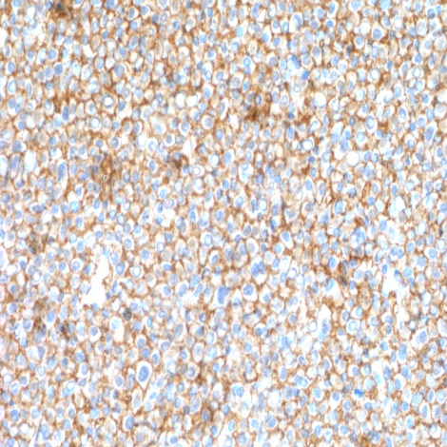
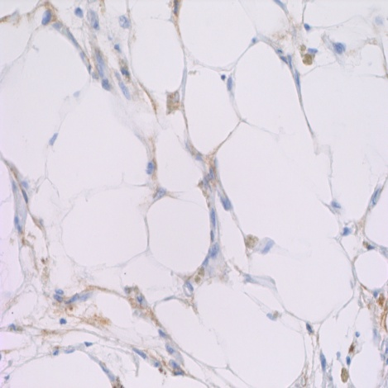
Adoptive T cell therapy: CAR-T cells in MM
Additional
regimens
including…
- carfilzomib
- pomalidomide
- vorinostat
- elotuzomab
CTL019 first undetectable
MRD-negative
sCR, MRD neg
Now d +307
TTP after ASCT #1 d190
Remission inversion
CD138
CD138
Stadtmauer, NEJM 2015

Slide 22
Adoptive T cell therapy: CAR-T cells in MM
CAR T or NK cells are engineered anti-tumor immune cells with high affinity chimeric antigen receptors specific for tumor antigens¹
Chimeric Antigen Receptor Structure¹
CAR-T in MM
Multiple promising targets:
CD19, CD138, CD38, CD56, kappa, Lewis Y, CD44v6, CS1, BCMA
CAR T and NK cells have in vitro and in vivo activity against MM
Many questions remain about CAR design:
optimal co-stimulatory domains
optimal vector
optimal dose and schedule
need for chemotherapy
Perhaps ‘cocktails’ of multiple CARs or CARs + chemotherapy will be required for best outcome.
Single-chain antibody able to recognize tumor-associated antigens in a non-MHC–specific manner
Molecular hinge region derived from CD8 to provide flexibility to allow reorientation to bind antigen
Cytoplasmic domain of CD28 and additional signaling domains, including CD137, were added to later generation CARs to enhance cytokine secretion and tumor growth inhibition
Cytoplasmic signaling domain of CD3ζ
1. Kershaw MH et al. Nat Rev Cancer. 2013;13:525-541.

Slide 23
CAR-BCMA T cells in MM: Study Design
First-in-human phase I trial
CAR-BCMA expression determined by flow cytometry
Pts with advanced R/R MM; ≥ 3 prior lines of therapy; normal organ function; clear, uniform BCMA expression on MM cells
(N = 12)
Cyclophosphamide 300 mg/m²
Fludarabine 30 mg/m²
QD for 3 days
CAR-BCMA T cells*
Single infusion
*Dose escalation of
CAR+ T cells/kg
0.3 x 10⁶
1.0 x 10⁶
3.0 x 10⁶
9.0 x 10⁶
Ali SA, et al. ASH 2015. Abstract LBA-1.
Notes:
BCMA, B-cell maturation antigen; CAR, chimeric antigen receptor; MM, multiple myeloma; R/R, relapsed/refractory.

Slide 24
CAR-BCMA T cells in MM: Results
Pt | Myeloma Type | CAR-BCMA Dose (T cells/kg) | Response | Response Duration, Wks
1 | κ light chain only | 0.3 x 10⁶ | PR | 2
2 | IgA λ | 0.3 x 10⁶ | SD | 6
3 | κ light chain only | 0.3 x 10⁶ | SD | 6
4 | κ light chain only | 1.0 x 10⁶ | SD | 12
5 | IgG κ | 1.0 x 10⁶ | SD | 4
6 | IgG λ | 1.0 x 10⁶ | SD | 2
7 | IgG λ | 3.0 x 10⁶ | SD | 7
8 | κ light chain only | 3.0 x 10⁶ | VGPR | 8
9 | κ light chain only | 3.0 x 10⁶ | SD | 16
10 | IgA λ | 9.0 x 10⁶ | sCR | 12+
11 | IgG λ | 9.0 x 10⁶ | PR | 6+
12 | IgA λ | 3.0 x 10⁶ | SD | 2
Pt 10: IgA MM with 3 prior lines of therapy. Relapse 3 mos after ASCT + melphalan 200 mg/m2
Pt 11: Advanced MM with 5 prior lines of therapy
Ali SA, et al. ASH 2015. Abstract LBA-1.
Notes:
BCMA, B-cell maturation antigen; CAR, chimeric antigen receptor; MM, multiple myeloma; R/R, relapsed/refractory.

Slide 25
Immune-therapies under investigation in Cancer
Immunotherapy^{1,2}
Active
(Designed to act on the immune system itself)
Passive
(Designed to act on the tumor)
I-O
therapies
Therapeutic
cancer vaccines
Antitumor
mAbs
Unspecific
Adoptive
Immune effector
cell modulators
Checkpoint
Inhibitors
Co-stimulatory agonists
Cell-based
DC-based cancer vaccines
Single antigen/
peptide-based
Cytokines
Interleukins
Interferons
IMiDs
Tumor-directed mAbs
Ab-drug Conjugates (ADC)
Cell therapies
Adoptive T-cell therapy
DC, dendritic cell; IMiD, immunomodulatory agent; I-O, immuno-oncology; mAb, monoclonal antibody.
Finn OJ. Ann Oncol. 2012;23(suppl 8 ):viii6-viii9. 2. Mellman I et al. Nature. 2011;480:480-489.

Slide 26
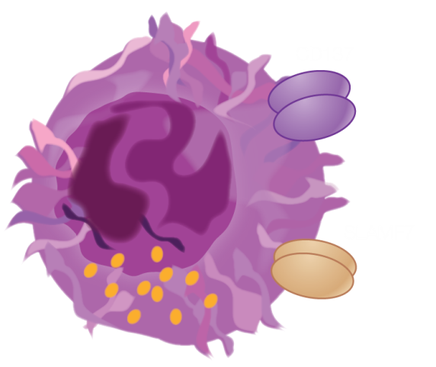

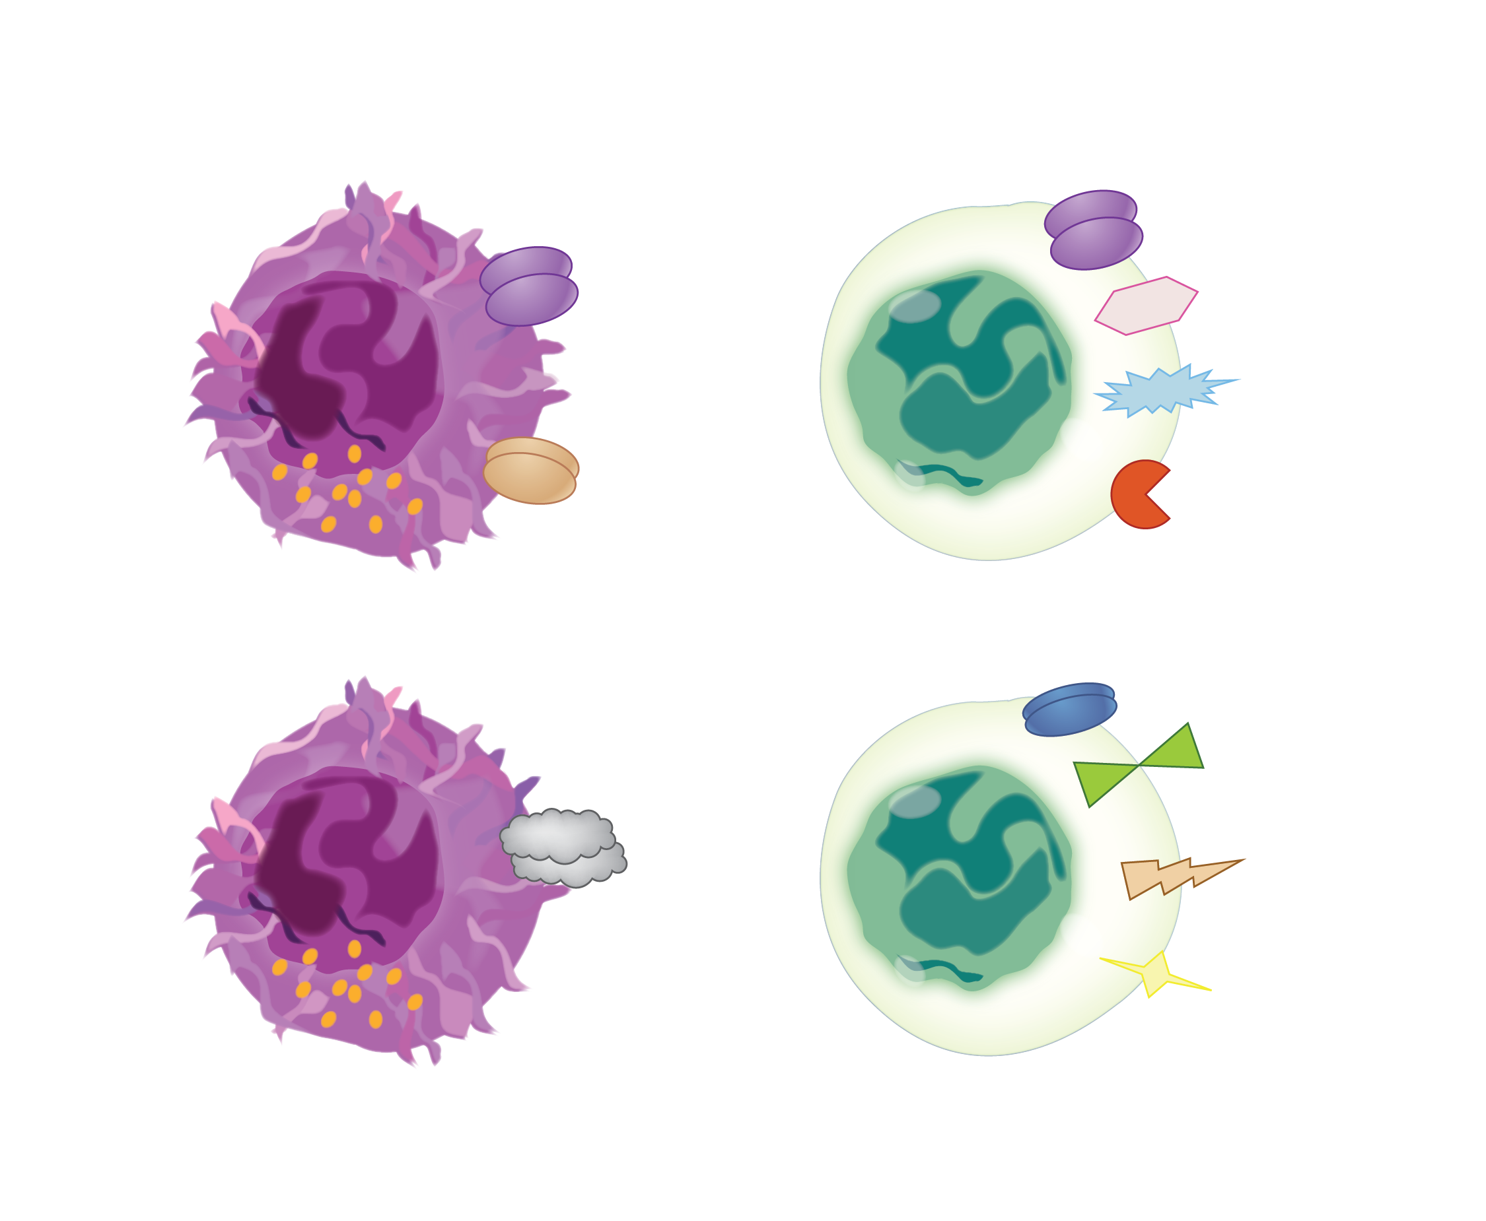
Immuno-oncology Activating/Inhibitory Pathways
Activating
CD137
CD137
CD40L
NK cell
T cell
CD28
SLAMF7
OX40
SLAMF7, signaling lymphocytic activation molecule family member 7.
Inhibitory
LAG-3
KIR
CTLA-4
PD-1
NK cell
T cell
B7-H3
receptor
KIR, killer cell immunoglobulin-like receptor; LAG-3, lymphocyte-activation gene 3;
CTLA-4, cytotoxic T-lymphocyte-associated protein 4; PD-1, programmed cell death protein 1.

Slide 27
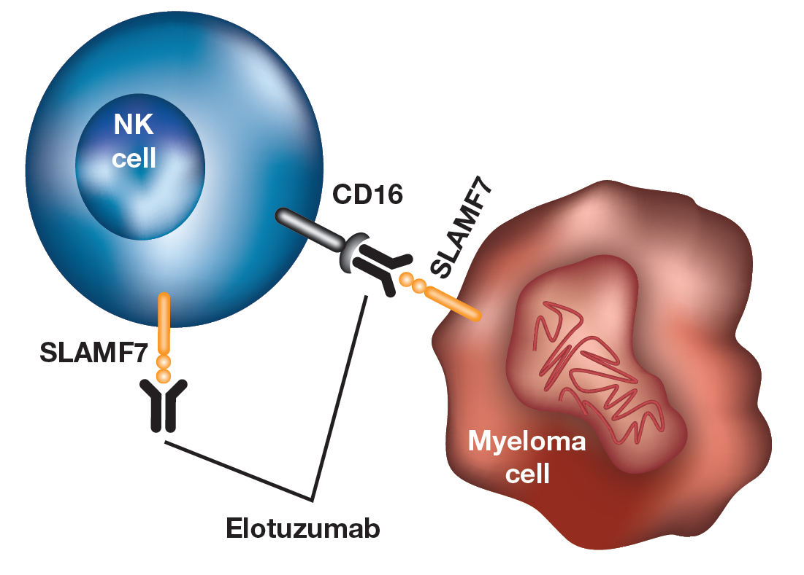
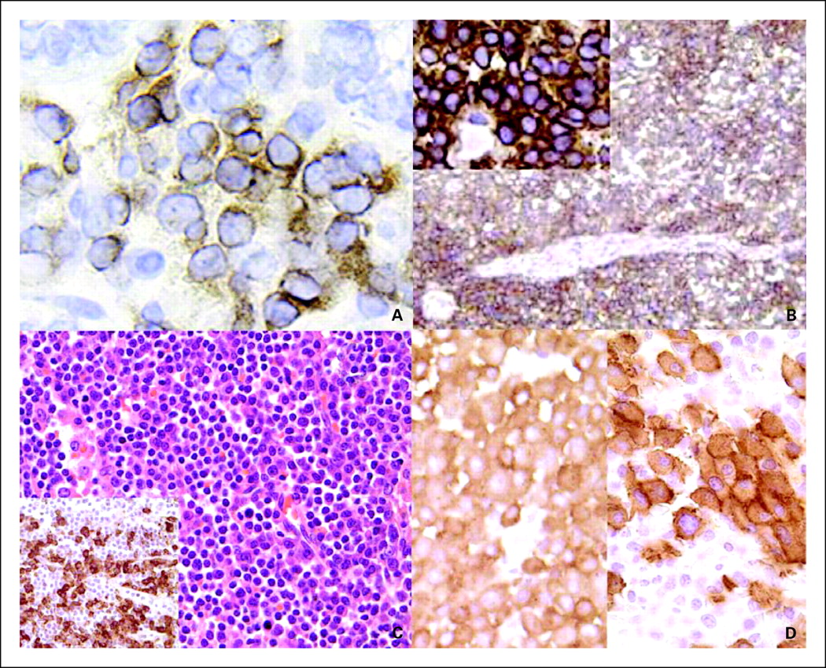
Elotuzumab (Anti-SLAM F7 MoAb) in MM
SLAMF7: Signaling Lymphocyte Activation Molecule-1. Also called CS1
Elotuzumab is a humanized IgG1 mAb targeting human CS1, a cell surface glycoprotein^{1,2}
CS1 is highly expressed on >95% of MM cells¹⁻³
Also on NK cells
Little to no expression on normal tissues
Dual mechanism of action
Normal plasma cells
Plasmacytoma
Binding to SLAMF7 directly activates Natural Killer cells,⁴ but not myeloma cells⁵
When bound to myeloma via SLAMF7, Elo activates Natural Killer cells via a CD16 mediated pathway, enabling selective killing via antibody-dependent cellular cytotoxicity (ADCC) with minimal effects on normal tissue
Phase I n=25 → 26% SD
Lymphoplasmacytic lymphoma
MM cells in bone marrow
Hsi ED et al. Clin Cancer Res. 2008;1; 2. Tai YT et al. Blood. 2008
3. Van Rhee F et al. Mol Cancer Ther. 2009; 4. Collins SM et al. Cancer Imm. Immunother. 2013
5. Guo H et al. Mol Cell Biol. 2014; 6. Zonder et al Blood 2012

Slide 28
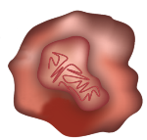



Elotuzumab synergizes with Lenalidomide in MM
Lenalidomide
Induces myeloma cell injury and lowers threshold for NK cell–mediated killing of myeloma cells by elotuzumab
SLAMF7
Myeloma Cell
ADCC
NK cell
+
CD16a
Elotuzumab
Direct NK cell activation
Lenalidomide
Enhances adaptive and innate immune system, including production of IL-2, to increase NK cell activity
ADCC, antibody-dependent cellular cytotoxicity; NK, natural killer; SLAMF7, signaling lymphocytic activation molecule family member 7
1. Balasa B et al. Cancer Immunol Immunother. 2015;64:61-73.

Slide 29
Eloquent-2: Elo + Ld vs Ld
Study Design
Open-label, randomized, multicenter, phase 3 trial (ELOQUENT-2)
Endpoints:
Co-primary: PFS and ORR
Other endpoints: overall survival (data not yet mature); duration of response, quality of life, safety
All patients received premedication to mitigate infusion reactions prior to Elo administration
Key inclusion criteria
RRMM
1–3 prior lines of therapy
Prior Len exposure permitted in 10% of study population (patients not refractory to Len)
Elo plus Len/Dex (E-Ld) schedule (n=321)
Elo (10 mg/kg IV): Cycle 1 and 2: days 1, 8, 15, 22; Cycles 3+: days 1, 15
Len (25 mg PO): days 1–21
Dex: weekly equivalent, 40 mg
Assessment
Tumor response: every 4 wks until progressive disease,
Survival: every 12 wks after disease progression
Len/Dex (Ld) schedule (n=325)
Len (25 mg PO): days 1–21;
Dex: 40 mg PO days 1, 8, 15, 22
Repeat every 28 days
Lonial et al. NEJM 2015

Slide 30
ELOQUENT-2
Co-Primary End Point: ORR
79
66
45
37
34
29
29
20
5
9
Overall response rate*
Combined response
(VGPR or better)
Complete response (sCR + CR)†
Very good partial response
Partial response
*Defined as partial response or better
†Complete response rates in the E-Ld group may be underestimated due to interference from therapeutic antibody in immunofixation and serum protein electrophoresis assay
Lonial et al. NEJM 2015 & Dimopoulos M, ASH 2015 Abst 28

Slide 31
ELOQUENT-2
Extended Progression-Free Survival
1.0
1-year PFS
2-year PFS
3-year PFS
0.9
 | E-Ld | Ld
HR 0.73 (95% CI 0.60, 0.89); p=0.0014
Median PFS (95% CI) | 19.4 mos (16.6, 22.2) | 14.9 mos (12.1, 17.2)
0.8
0.7
68%
0.6
Probability progression free
0.5
57%
41%
0.4
26%
0.3
E-Ld
0.2
27%
18%
Ld
0.1
0.0
0
3
6
9
12
15
18
21
24
27
30
33
36
39
42
45
48
No. of patients at risk:
E-Ld
Ld
PFS (months)
321
325
293 266
259
215
227
181
195
157
171
130
144
106
125 80
107
67
94
60
85
51
59
36
34
15
19
7
8
3
3
0
0
0
PFS benefit with E-Ld was maintained over time (vs Ld):
Overall 27% reduction in the risk of disease progression or death
Relative improvement in PFS of 44% at 3 years
Lonial et al. NEJM 2015 & Dimopoulos M, ASH 2015 Abst 28

Slide 32
ELOQUENT-2
Time to Next Treatment
 | E-Ld |  | Ld
HR 0.62 (95% CI 0.50, 0.77)
Median TTNT (95% CI) |  | 33 mos (26.15, 40.21) | 21 mos (18.07, 23.20)
1.0
0.9
0.8
0.7
0.6
Probability of patients without
next treatment
E-Ld
0.5
0.4
0.3
0.2
Ld
0.1
0.0
0
2
4
6
8
10
12
14
16
18
20
22
24
26
28
30
32
34
36
38
40
42
44
46
48
Time to next treatment (months)
No. of patients at risk:
E-Ld
Ld
321
325
315
305
294
276
282
251
259
232
239
206
225
193
208
174
198
166
182
148
174
135
165
120
153
105
144
96
138
89
126
85
118
76
94
46
65
30
46
20
32
13
14
5
6
3
3
1
0
0
E-Ld-treated patients had a median delay of 1 year in the time to next treatment vs Ld-treated patients
Dimopoulos M, ASH 2015 Abst 28

Slide 33
Check-Point Inhibitors

Slide 34
Immuno-oncology Activating/Inhibitory Pathways
Activating
CD137
CD137
CD40L
NK cell
T cell
CD28
SLAMF7
OX40
SLAMF7, signaling lymphocytic activation molecule family member 7.
Inhibitory
LAG-3
KIR
CTLA-4
PD-1
NK cell
T cell
B7-H3
receptor
KIR, killer cell immunoglobulin-like receptor; LAG-3, lymphocyte-activation gene 3;
CTLA-4, cytotoxic T-lymphocyte-associated protein 4; PD-1, programmed cell death protein 1.

Slide 35
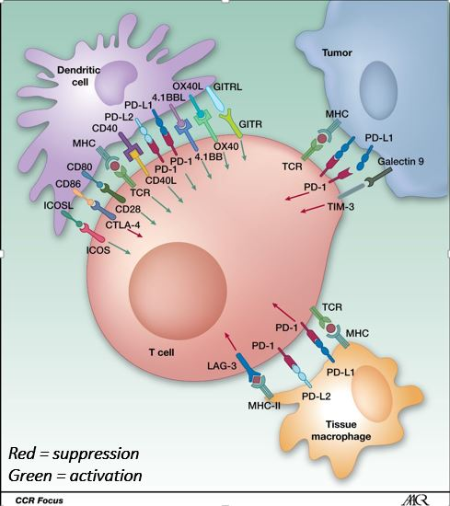
Check Point inhibitors
T cells express Check Points:
PD-1 → PD-L1 & PD-L2
CTLA-4 →CD86
LAG-3 → MHC-II
TIM-3 → Galectin 9
Tumor cells (MM) express PD-L1
Macrophages and dendritic cells express PD-L1 and PD-L2 that can inhibit or activate the immune system

Slide 36
Preliminary Results of a Phase I Study of Nivolumab in Patients with Relapsed or Refractory Lymphoid Malignancies
Alexander M. Lesokhin¹ , Stephen M. Ansell², Philippe Armand³, Emma C. Scott⁴, Ahmad Halwani⁵, Martin Gutierrez⁶, Michael M. Millenson⁷, Adam Cohen⁸, Stephen J. Schuster⁸, Daniel Lebovic⁹, Madhav Dhodapkar¹⁰, David Avigan¹¹, Bjoern Chapuy³, Azra H. Ligon¹², Scott J. Rodig¹², Deepika Cattry¹, Lili Zhu¹³, Joseph F. Grosso¹³, Su-Young Kim¹³, Margaret A. Shipp³, Ivan Borrello¹⁴, John M. Timmerman¹⁵
¹Memorial Sloan Kettering Cancer Center and Weill Cornell Medical College, New York, NY; ²Mayo Clinic, Rochester, MN; ³Dana-Farber Cancer Institute, Boston, MA; ⁴ Oregon Health and Science University and the Knight Cancer Institute, Portland, OR; ⁵University of Utah Huntsman Cancer Institute, Salt Lake City, UT; ⁶John Theurer Cancer Center, Hackensack University Medical Center, Hackensack, NJ; ⁷Fox Chase Cancer Center, Philadelphia, PA; ⁸Abramson Cancer Center, University of Pennsylvania, Philadelphia, PA; ⁹University of Michigan Hematology, Ann Arbor, MI; ¹⁰Yale Cancer Center, New Haven, CT; ¹¹Beth Israel Deaconess Medical Center, Boston, MA; ¹²Brigham and Women’s Hospital Clinical Cytogenetics Laboratory, Boston, MA; ¹³Bristol-Myers Squibb, Princeton, NJ; ¹⁴Johns Hopkins University School of Medicine and the Sidney Kimmel Comprehensive Cancer Center, Baltimore, MD; ¹⁵Jonsson Comprehensive Cancer Center, University of California, Los Angeles, CA
56th Annual ASH Meeting
December 2014
San Francisco, CA

Slide 37
RR of Nivolumab (Anti-PD1) in Haem Malignancies
Tumor Type | # pts | ORR | CR | PR | SD
Multiple Myeloma | 27 | 1 (4) | 1 (4) | 0 | 17 (63)
B-Cell Non-Hodgkin Lymphoma | 31 | 8 (26) | 3 (10) | 5 (16) | 16 (52)
Diffuse Large B-Cell | 11 | 4 (36) | 2 (18) | 2 (18) | 3 (27)
Follicular NHL | 10 | 4 (40) | 1 (10) | 3 (30) | 6 (60)
Mantle Cell Lymphoma | 4 | 0 | 0 | 0 | 3 (75)
Primary Mediastinal B-Cell | 2 | 0 | 0 | 0 | 2 (100)
Other B-NHL | 4 | 0 | 0 | 0 | 2 (50)
T-Cell Non-Hodgkin Lymphoma | 23 | 4 (17) | 0 | 4 (17) | 10 (43)
CTCL/MF | 13 | 2 (15) | 0 | 2 (15) | 9 (69)
Peripheral T-Cell | 5 | 2 (40) | 0 | 2 (40) | 0
Other T-NHL | 5 | 0 | 0 | 0 | 1 (20)
Hodgkin Lymphoma | 23 | 20 (87) | 6 (26) | 14 (61) | 3 (13)
*includes other B-cell lymphoma (n=8) †includes other cutaneous T-cell lymphoma (n=3) and other non-cutaneous T-cell lymphoma (n=2)
Lesokhin. EHA 2015

Slide 38
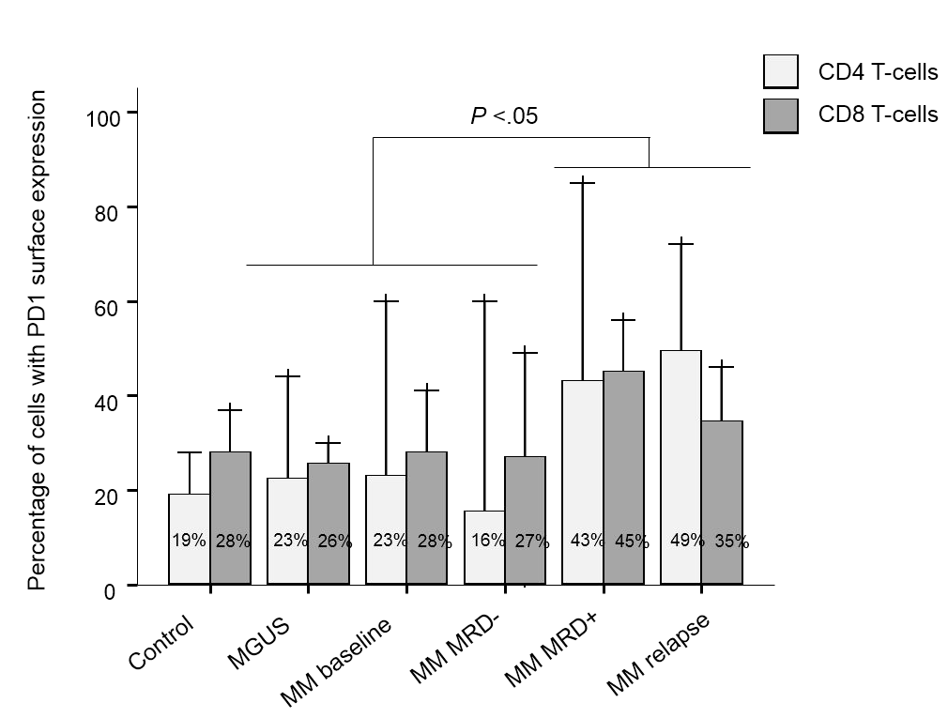
Novel strategies with Anti-PD1 MoAb in MM
Use in other settings → MRD situation (GEM-Pembresid)
Combinations
Pembrolizumab + Lenalidomide + Dexamethasone
Nivolumab + Pomalidomide + Dexamethasone (NivoPomDex)
+ Other Check-Points inhibitors: Elo + Urelumab (antiCD137) vs Elo + Lirilumab (anti KIR)
T lymphocytes (CD4 & CD8) of patients in CR with persistent MRD display the highest expression of PD1.
Paiva. Leukemia 2015

Slide 39
Keynote-023
Pembrolizumab + LD Antitumor Activity
Treatment Exposure & Response Duration
→
→
→
→
Best Response (n (%)
→
→
→
→
 | Efficacy Population† (n = 40) | Len-Refr (n = 29)
ORR | 20 (50) | 11 (38)
sCR | 1 (3) | 1 (3)
VGPR | 5 (13) | 3 (10)
PR | 14 (35) | 7 (24)
SD | 19 (48) | 17 (59)
PD | 1 (3) | 1 (3)
→
→
→
→
PR
VGPR
CR
sCR
PD
→
Treatment ongoing
0
5
10
Months
15
20
25
Median follow-up: 9 months (range, 1-25)
Median DOR: 11.3 months
Median time to achieve first objective response: 1.5 months (range, 1.0-6.6)
4 patients who responded (20%) upgraded the quality of response
75% of patients were still alive
†11 patients NE by central review
3 discontinued within cycle 1 for reasons other than PD (2 no treatment assessments and 1 SD by investigator)
8 inadequate myeloma data for response assessment (5 PD and 3 SD by investigator)
Mateos MV ASCO 2016

Slide 40
Check Point inhibitors: Pembrolizumab + LD
Panob + Bort
Benda Bort-Dex
VBAD
VBCMP
DCEP
LGH447
49 years. Male
Diagnosed in 2010 of MM IgG kappa
Initial Tx
BD + Caelyx MR
ASCT Refr
LD Refr
LD + Pembr.
Pom-D
CC223
San Miguel JF, ASH 2015 Abst 505

Slide 41
Check Point inhibitors: Pembrolizumab + LD
Panob + Bort
Benda Bort-Dex
VBAD
VBCMP
DCEP
LGH447
49 years. Male
Diagnosed in 2010 of MM IgG kappa
Initial Tx
BD + Caelyx MR
ASCT Refr
LD Refr
LD + Pembr.
Pom-D
CC223
Immunotherapy is one of the most promising strategies in cancer
Passive: MoAb, BiTE, ADC, CAR-T cells
Active: anti-SLAMF7 MoAb, Check Point Inhibitors
Need for including patients in clinical trials
Personalized therapy: Who will / will not respond to which agent?
Novel methods of evaluating the activity of these novel agents are required.

Slide 42
Acknowledgments
Cancer Research Center
University Hospital
Laboratory 12
Enrique M. Ocio
Mercedes Garayoa
Teresa Paíno
Ana Alicia López Iglesias
Susana Hernández García
Macarena Algarín
Laura San Segundo
Montserrat Martín
Lorena González
Department of Hematology
Mª Victoria Mateos
Ramón García-Sanz
Norma C. Gutiérrez
Noemí Puig
Mª Consuelo del Cañizo
Jesús F. San Miguel
University of Salamanca - Spain

Slide 43
Institute of Biomedical Research of Salamanca
Cancer Research Center
University of Salamanca
Inmunoterapia aplicada al MM
Enrique M. Ocio
University Hospital & Cancer Research Center
University of Salamanca
Spain

